Slide 1
Soft Robotics
David Camparmo

Slide 2
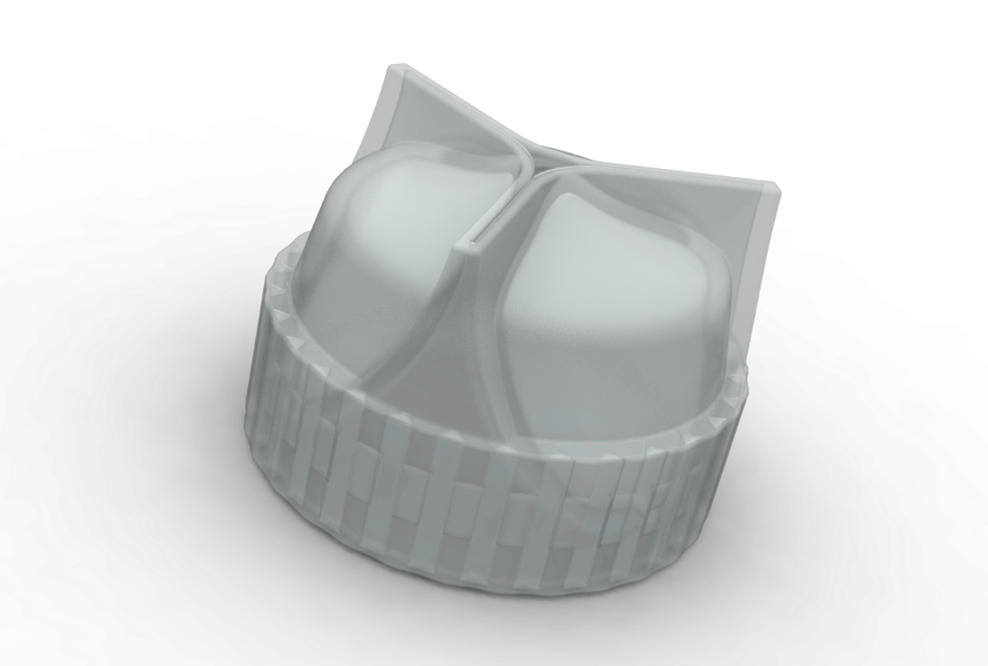
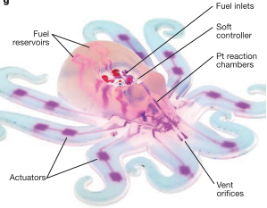
What Are Soft Robots
Soft Robots are devices or machines made of elastic materials such as hydrogels, elastomers or polymers

Slide 3
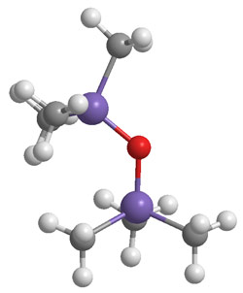
What is a Polymer
A material consisting of very large molecules in many repeating sub unites
Natural (wool, silk, rubber)
synthetic (polystyrene, synthetic rubber, silicone)

Slide 4
Creating a Soft Robot
Methods for creating a soft robot
Shape Deposition Manufacturing (SDM)
Soft Composite Microstructure (SCM).
3D Printing
Ideal materials for creating a soft robot have the two main characteristics
Elastic, deformable

Slide 5
Control Method
Electric Field - Can produce large forces, can be self-sensing, and have fast actuation rates (10ms - 1s). But requires a high voltage to function and can often leak current
Thermal - Made from Shape-Memory Polymers which can retain 2 or more shapes and transitions between them with changes in temperatures. A major disadvantage of this method is its slow response (>10s)
Pressure difference - Pneumatic Artificial Muscles (PAM), relies on changes in pressures in a flexible cavity to produce motion in the actuator

Slide 6
Soft Sensors
The sensors in used in soft robotics them selves soft
Sensor Types
Stretch
Bending
Pressure
Force
Sensor Detect
Capacitance
Magnetic fields
Optical loss
Acoustic loss

